Slide 1
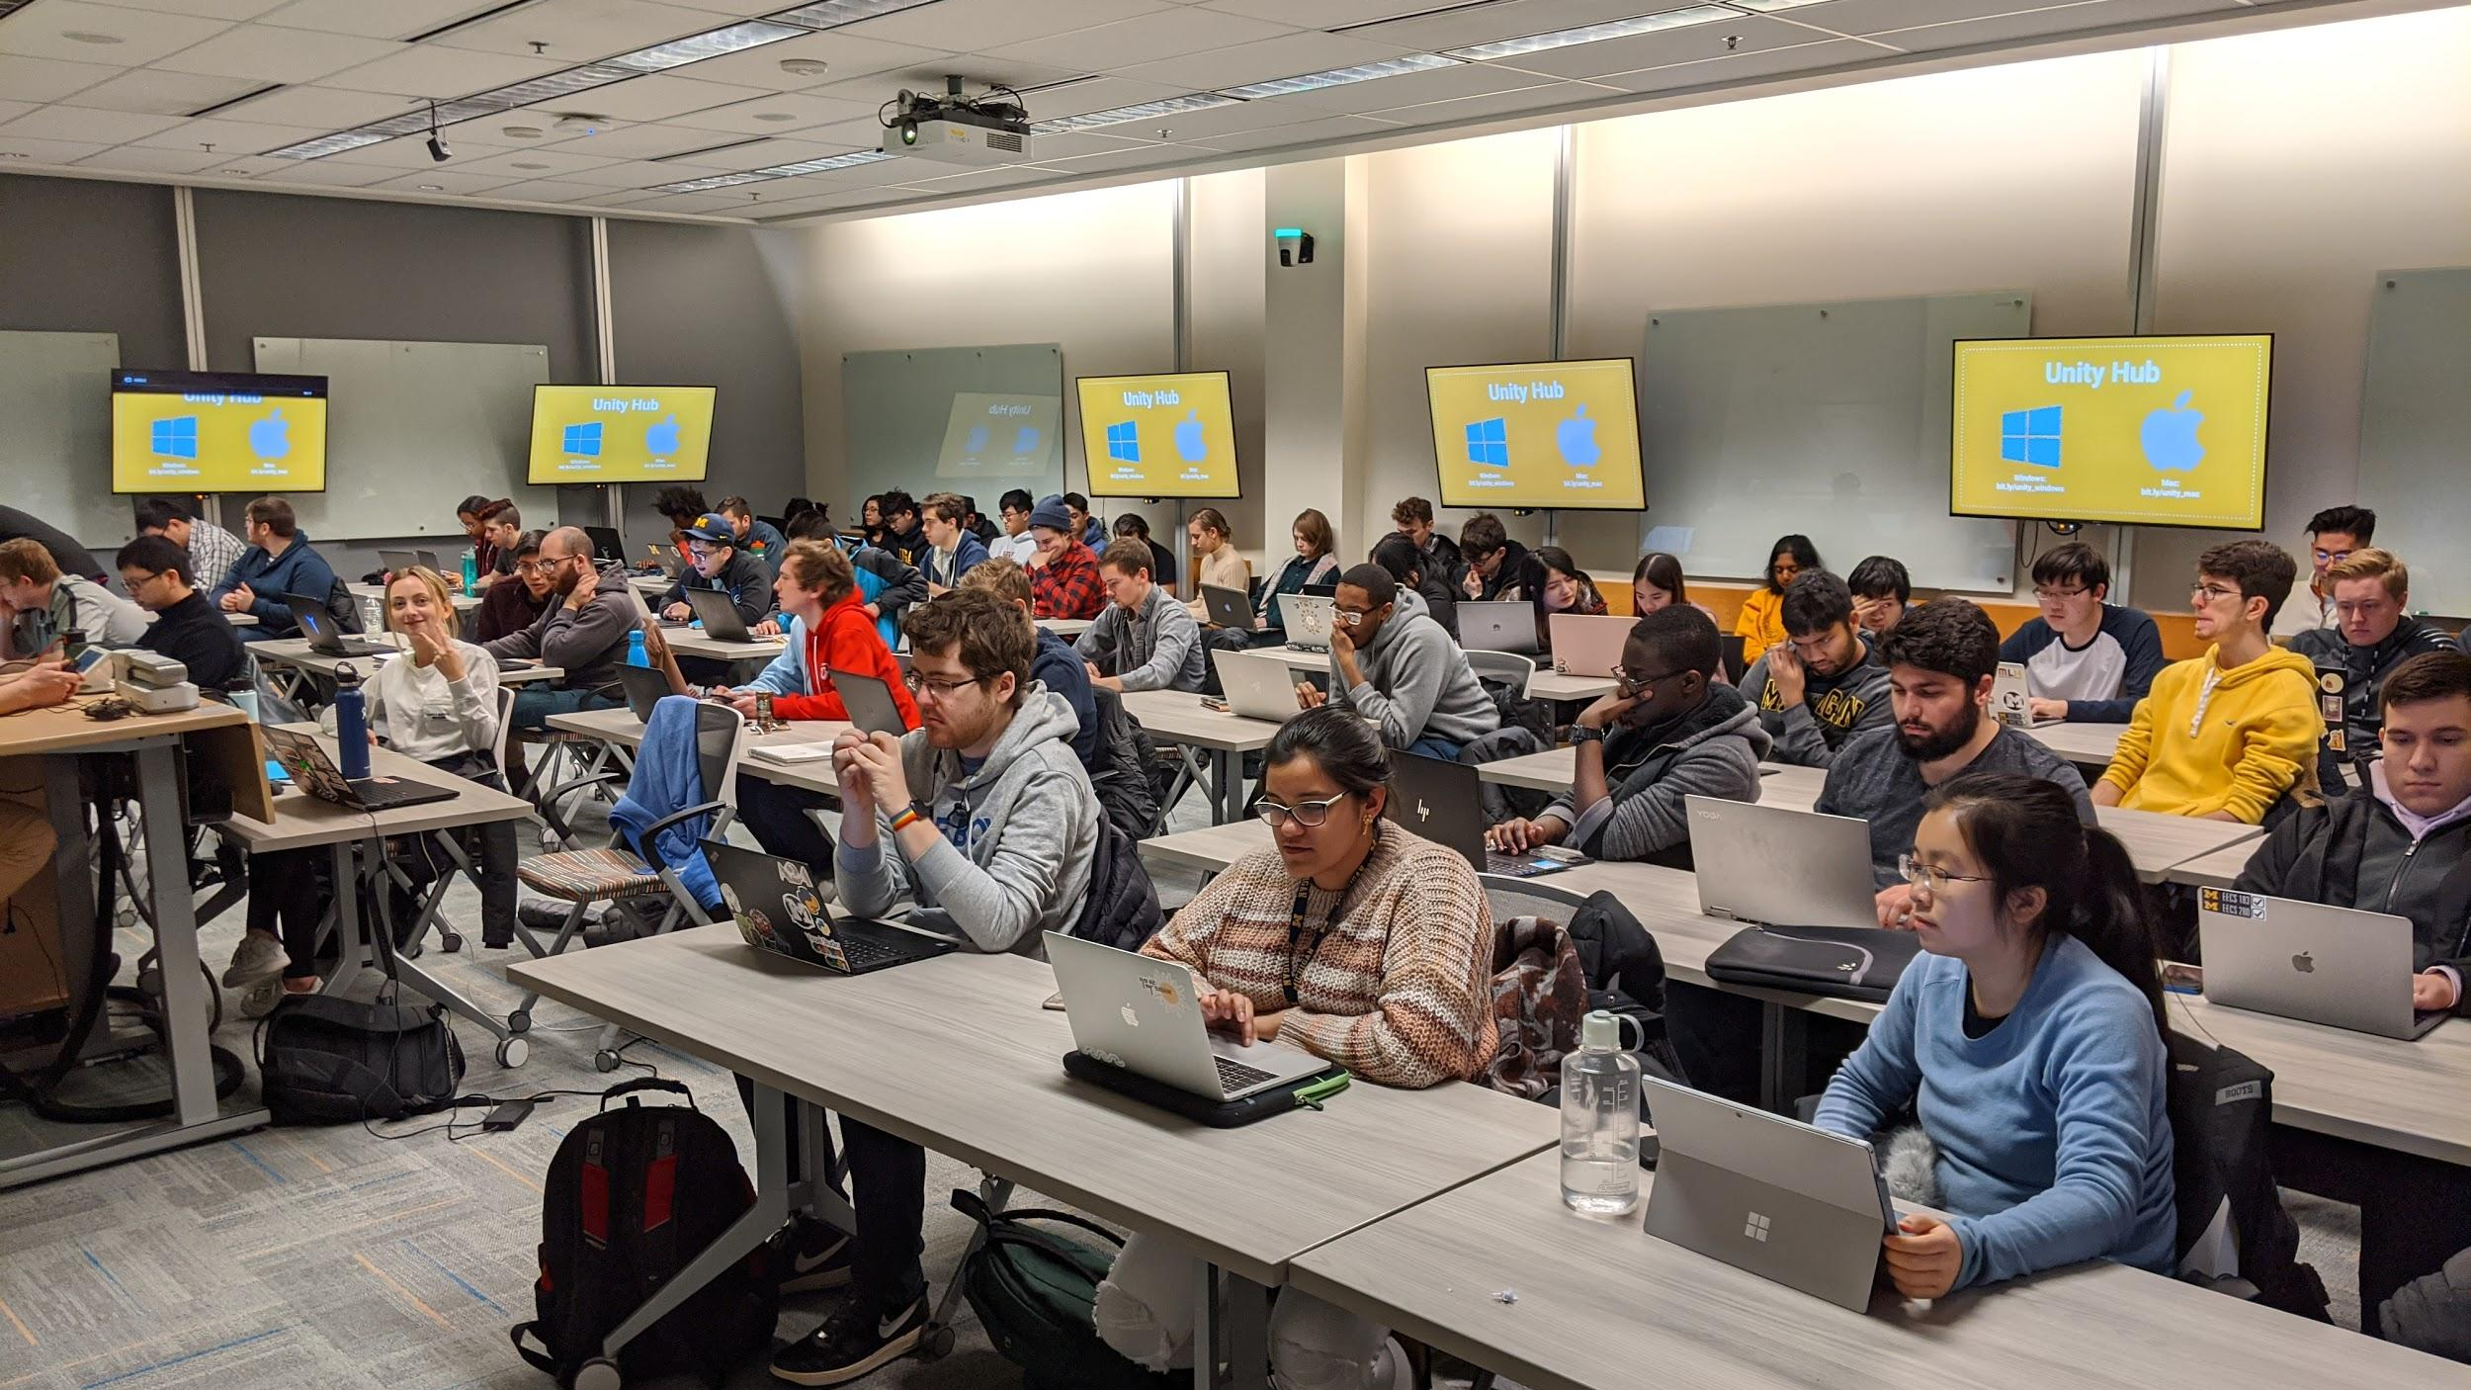
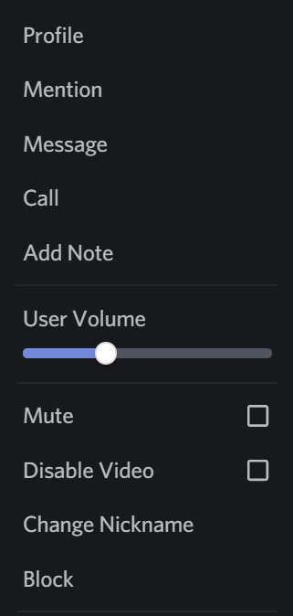


WolverineSoft Studio
Pre-Alpha II
Dislike the music?
Right-click on Groovy in the Voice Chat list, and either turn down his volume or mute him entirely!
Now Playing: Various Video Game OSTs
02.21.2021

Slide 2
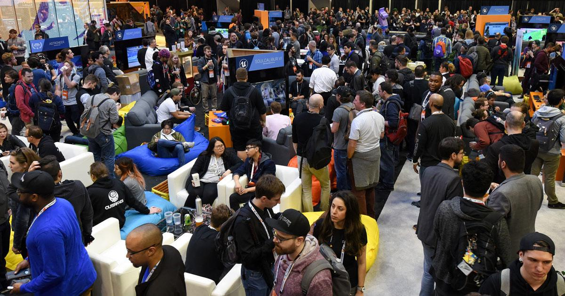



AGENDA
State of the Game
Announcements
Progress Thus Far
Looking Forward
MDP Students + Assignment
Final Thoughts
Pod & Department Meetings

Slide 3

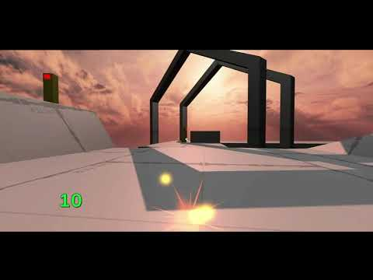
STATE OF THE GAME

Slide 4
AGENDA
State of the Game
Announcements
Progress Thus Far
Looking Forward
MDP Assignment
Final Thoughts
Pod & Department Meetings

Slide 5
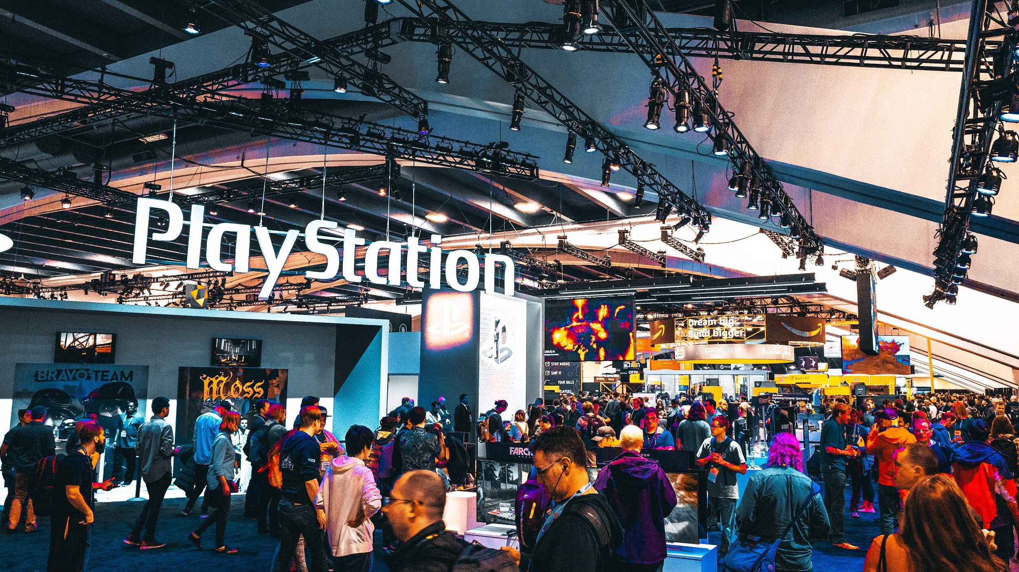

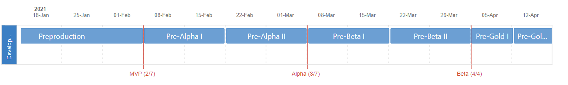
ANNOUNCEMENTS
Timeline Reminder
These next two weeks (2/7 - 2/21) will be our Pre-Alpha II sprint. This is our second week of production!
By the end of our Alpha phase, some representation of every feature in the game should be in our builds. Alpha means feature-lock, and will end on 3/7 (one month from today)!

Slide 6
AGENDA
State of the Game
Announcements
Progress Thus Far
Looking Forward
MDP Assignment
Final Thoughts
Pod & Department Meetings

Slide 7

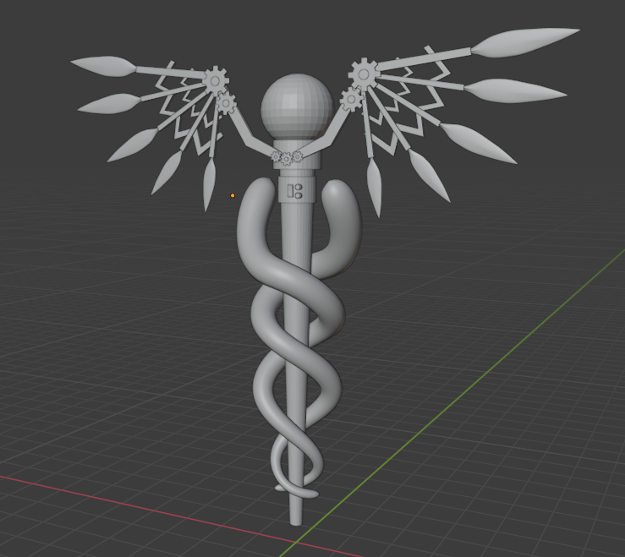
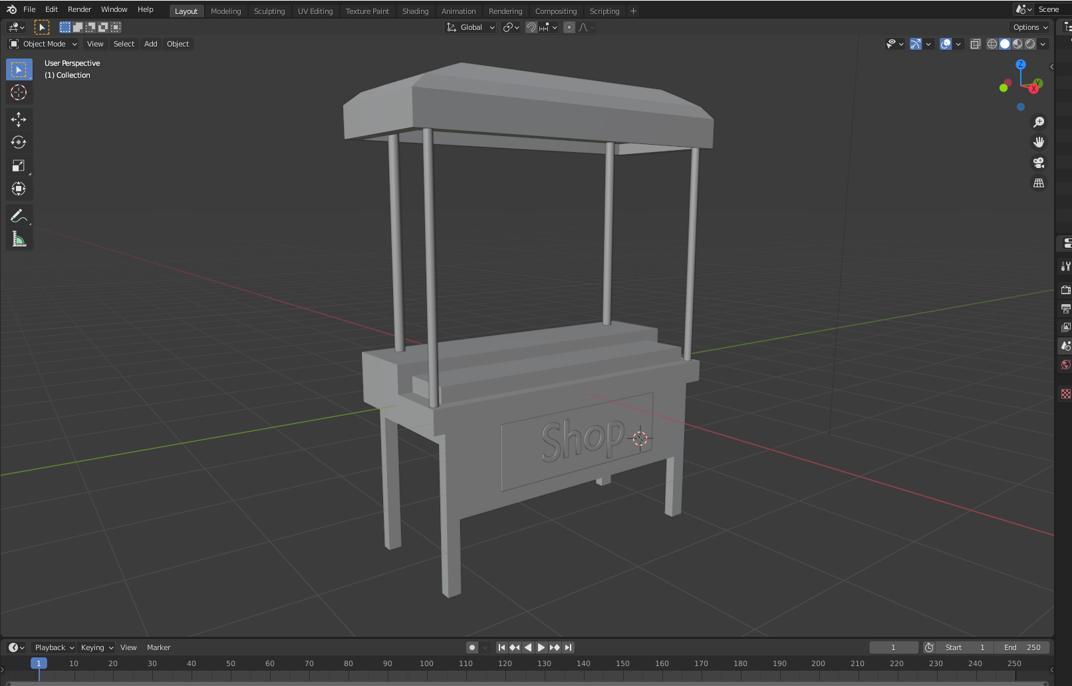
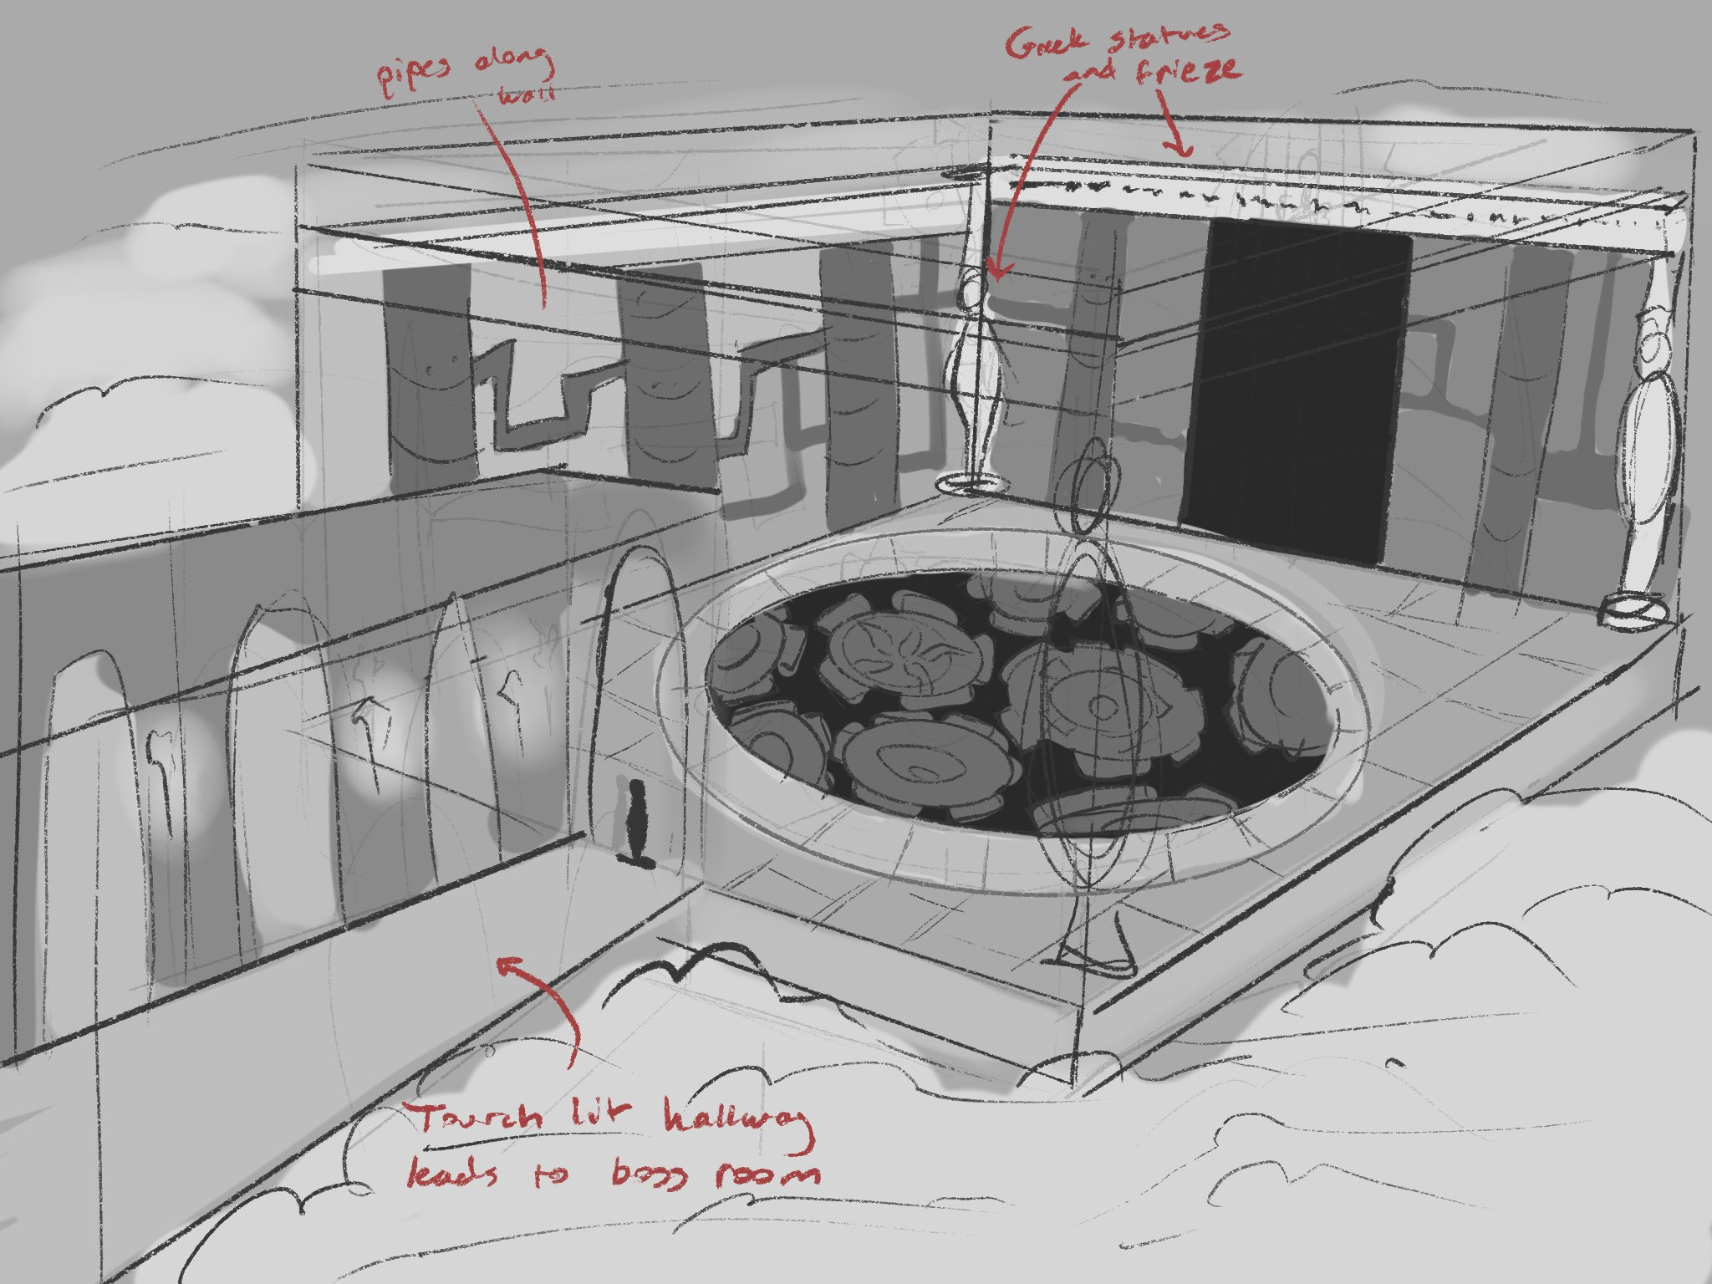
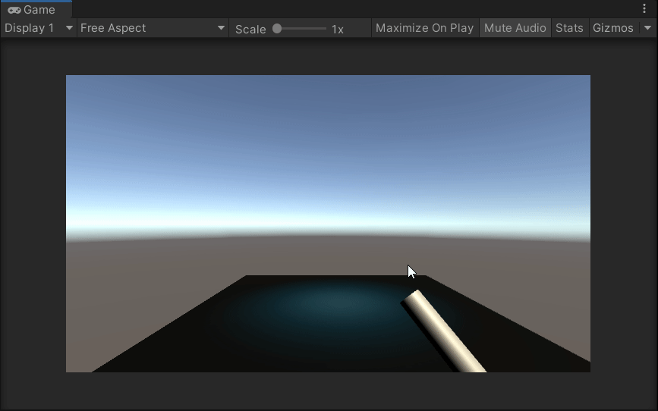
Art Department
Caduceus Model
Shop Stand Model
Environment Concepts
by Lucy Zhang
by Marlon Berry
by Natalie Neumann
Shooting VFX
by Grace Ma

Slide 8

Audio Department
Main Menu Music
Battle Demo Intro
Stat Raised & Purchase VFX
by Emily Sulkey
by Shreya Patibanda
by Steve Klingbiel

Slide 9

Programming Department
Skill Tree System
Knockback System
Slowdown Mechanic
by Nikhil Ghosh
by Michael Stowe
by Steven Tam

Slide 10

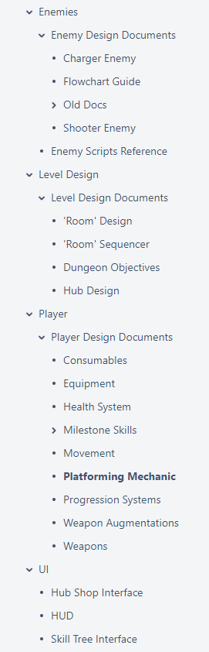
Design Department

Slide 11

...This really doesn’t begin to cover the progress made!
Participate in the preview channels! Your feedback is appreciated!

Slide 12
AGENDA
State of the Game
Announcements
Progress Thus Far
Looking Forward
MDP Assignment
Final Thoughts
Pod & Department Meetings

Slide 13
Pre-Alpha II
90-percent loop
Import 3rd party assets
Enemy AI
User Interface art
Skills & Milestones
……..
Please update Jira religiously! If you don’t, we have no way of knowing how much progress is made.
Try to get your tasks finished early! When working on tasks, communicate with designers. Set up pair working sessions, if you can! This ensures that everyone is on the same page.

Slide 14
AGENDA
State of the Game
Announcements
Progress Thus Far
Looking Forward
MDP Assignment
Final Thoughts
Pod & Department Meetings

Slide 15

MDP ASSIGNMENT
Your first Dev Blog is due on tonight at 11:00 PM ET
Remember to log your progress into a development blog post. This will be due at the end of every sprint!
If at any point you run out of tasks to work on to fill your hours requirement, definitely let us know ASAP, but you will still need to fill additional hours with independent work. This can include:
Completing Unity tutorials
Playtesting & providing feedback in preview channels
Researching & playing similar games and implementations
etc...
If you need help doing this, or have any questions, DM me on Discord!

Slide 16
AGENDA
State of the Game
Announcements
Progress Thus Far
Looking Forward
MDP Assignment
Final Thoughts
Pod & Department Meetings

Slide 17
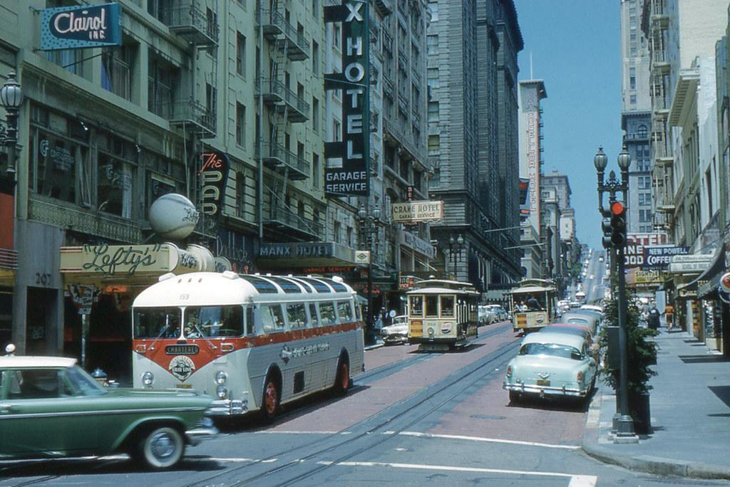

Reflections
We are going to take 5 minutes.
During this time, please visit this page (I will link it in chat): https://studio.eecs.umich.edu/confluence/x/wQZKAQ
We are always looking to improve, and your feedback is incredibly valuable. Please list the things you loved, longed for, loathed, and learned from this past sprint. The leads will go over these notes together at our next meeting.

Slide 18
Reminders
Weekly meetings, Sundays 2-4 PM on WolverineSoft Studio Discord server
Our next meeting will take place on 2/28!
WolverineSoft has a Minecraft server! Follow this setup guide to learn how to join!
Another community night coming soon, likely next Saturday!
Message me on Discord any time if you have any general Studio questions!

Slide 19
AGENDA
State of the Game
Announcements
Progress Thus Far
Looking Forward
MDP Assignment
Final Thoughts
Pod & Department Meetings

